Slide 1

Euthanasia should be another option to choose
Speaker : 統計系112 李宗祐

Slide 2

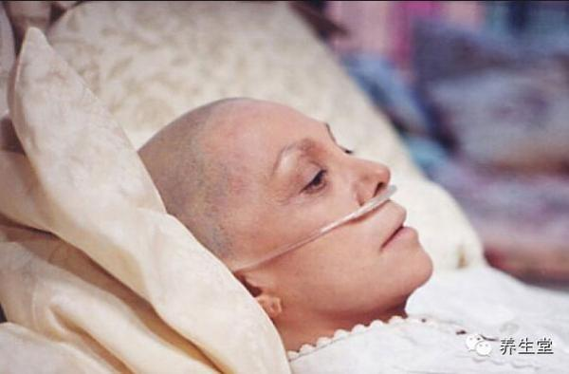

What we prolong is a meaning life or endless pain?

Slide 3

Life ?death?

Slide 4
Outline
We need it !
We want it !
We can control it !

Slide 5
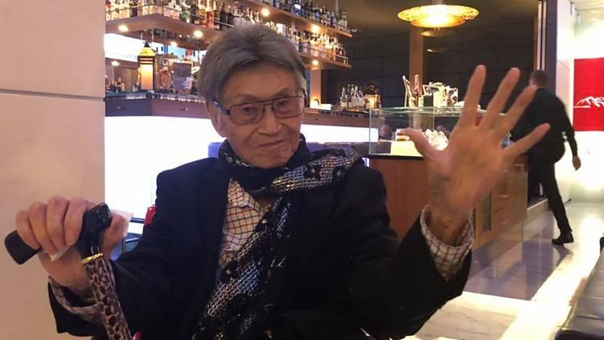
We need it
>Death is only way to be rescued.
>Die with dignity
傅達仁

Slide 6
Why we want it? We want to choose when to die.
Why not take action when you have enough energy and time.

Slide 7

We want it !
Fulfill dreams
Cherish time rather than receive treatment in vain
More meaningful life

Slide 8
Worry about negative effect?

Slide 9
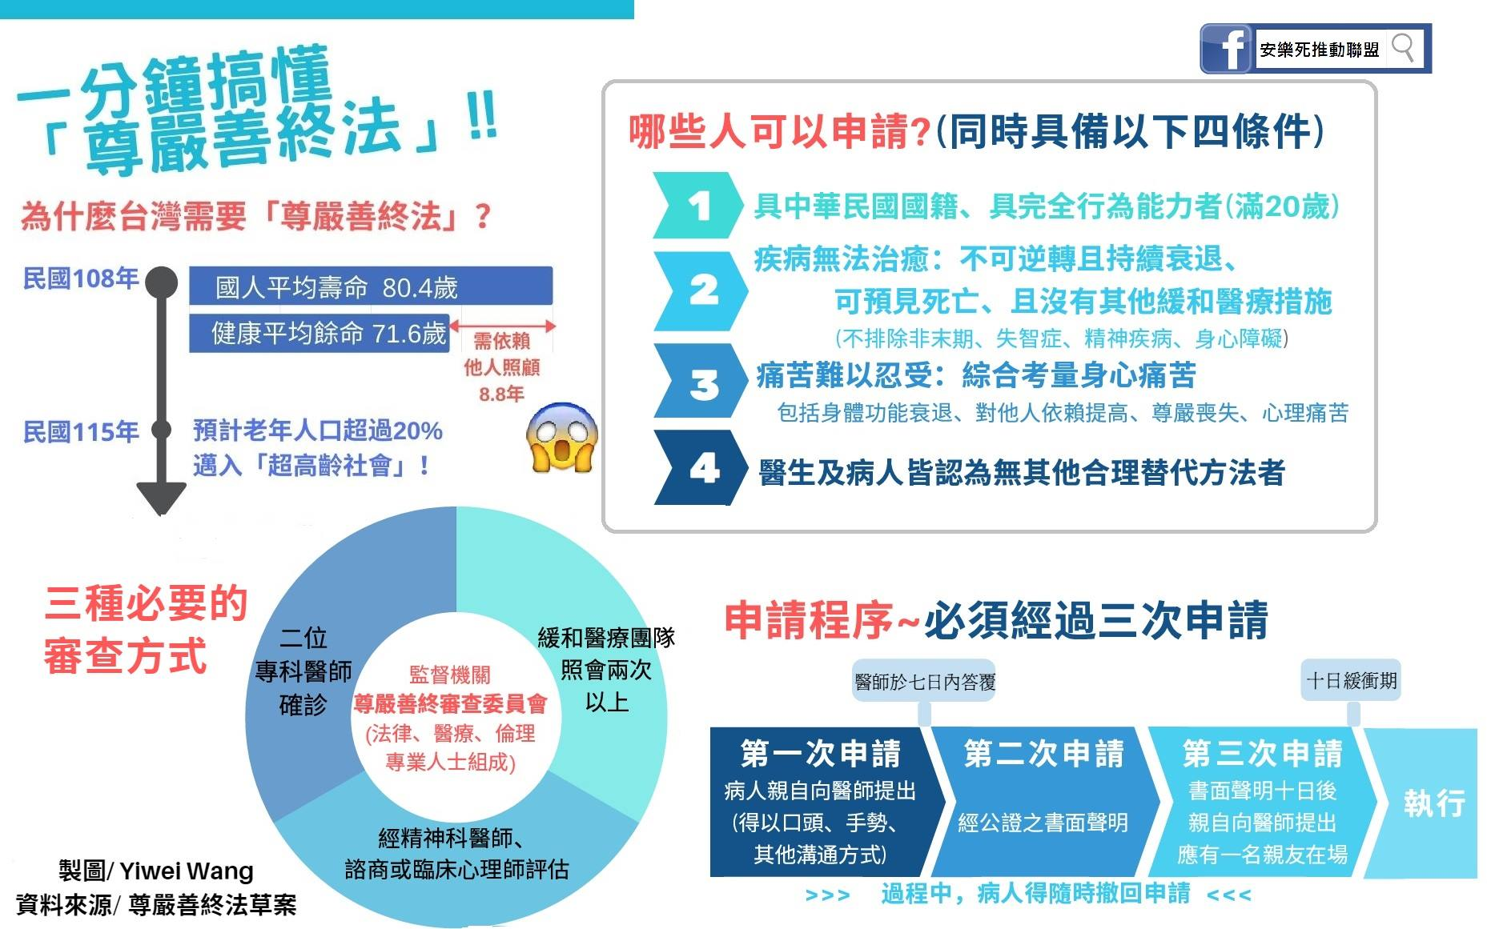
We can control it !
> Higher standard

Slide 10
Final remarks
No one want to leave the world when they are able to change.
They need it ! They want it ! And also , we can control it !
Support euthanasia in Taiwan , give them a peaceful way to leave .

Slide 11
Take home message
Hope we don’t need it , but be glad the option is there

Slide 12
Q&A ?

